Slide 1


Introduction to React Components
React components are building blocks of React applications. They are reusable, self-contained pieces of code that render user interface elements.
NAME:G.SOWMYA
ROLL NO:22H51A0588

Slide 2
What are React Components?
Reusable
Modular
State Management
Components can be used multiple times throughout your application, reducing code duplication.
Components are independent units that can be developed and maintained separately.
Components can hold their own data and logic, making them responsible for managing their state.
UI Elements
Components render specific parts of the UI, like buttons, forms, or navigation menus.

Slide 3
Functional Components
1
Simple Structure
2
Pure Functions
3
No State
Functional components are a straightforward way to define UI elements.
They are pure functions that take props as input and return JSX representing the UI.
Functional components don't have their own internal state.
4
Hooks
Hooks allow functional components to access state and other React features.

Slide 4
Class Components
State Management
Lifecycle Methods
Legacy Approach
Class components have their own state, which can be updated to change the UI.
Class components have lifecycle methods that are called at specific stages in their lifecycle, like when they mount or unmount.
Class components are gradually being replaced by functional components with hooks.
constructor()
Less code
this.state = {}
componentDidMount()
Easier to understand
this.setState()
componentWillUnmount()
More performant
shouldComponentUpdate()

Slide 5
Component Lifecycle
Mounting
1
The component is created and inserted into the DOM.
2
Updating
The component receives new props or its state changes, causing a re-render.
Unmounting
3
The component is removed from the DOM.

Slide 6

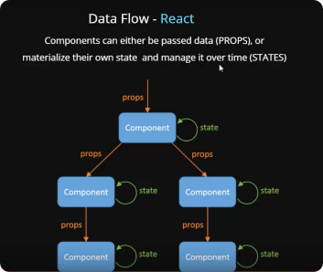
Properties and State
Properties
State
Passed from parent component
Managed by the component itself
Immutable
Mutable
Used to configure the component
Used to represent the internal data of the component

Slide 7
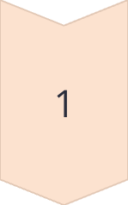
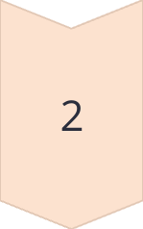
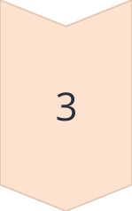
Handling Events
Event Listener
Attach event listeners to HTML elements within your component.
Event Handler
Define a function that will be executed when the event occurs.
Event Object
The event object provides information about the event, such as the target element.

Slide 8
Conditional Rendering
1
Logical Operators
2
State
3
Props
Use logical operators like if/else statements or ternary operators to determine which elements to render.
Conditional rendering based on the component's state allows you to dynamically change the UI.
You can render different content based on the props passed to the component.
4
Operators
&&, ||, ?: can be used to determine which element to render based on a condition.

Slide 9
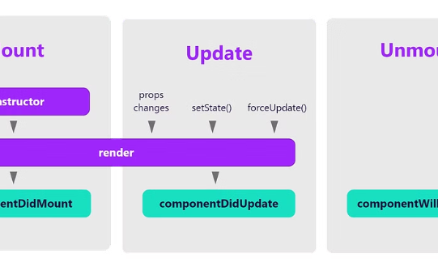
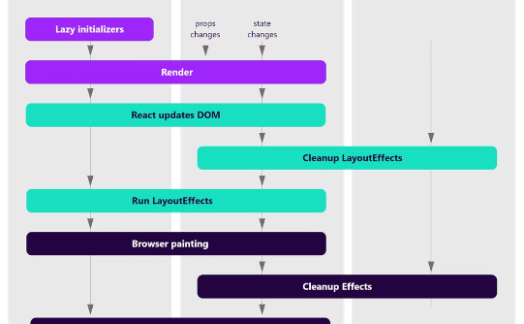
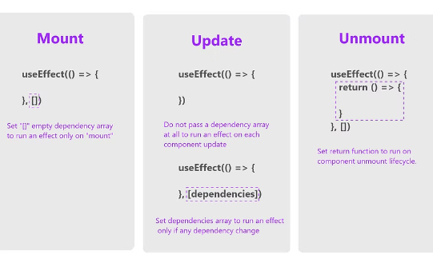
Reusable Components
Header
Button
Form
Reusable header component for displaying a website logo and navigation.
Reusable button component for different actions like "Submit" or "Cancel".
Reusable form component for collecting user input.

Slide 10
Best Practices for React Components
Maximize Reusability
Separation of Concerns
Performance Optimization
Accessibility
Design components that can be used in multiple parts of your application.
Keep components focused on specific functionalities and responsibilities.
Ensure your components are accessible to users with disabilities.
Minimize re-renders by using memoization or React's built-in optimization techniques.

Slide 11
THANK YOU

